Slide 1
World Cup Data Visualization
Ismayil Ismayilov
Vadym Dudarenko

Slide 2
Libraries
tidyverse
ggplot2
dplyr
ggthemes
tidyr
forcats
fmsb

Slide 3
Data
WorldCupMatches
WorldCup1930-2014
WorldCup2022
StatsBomb

Slide 4
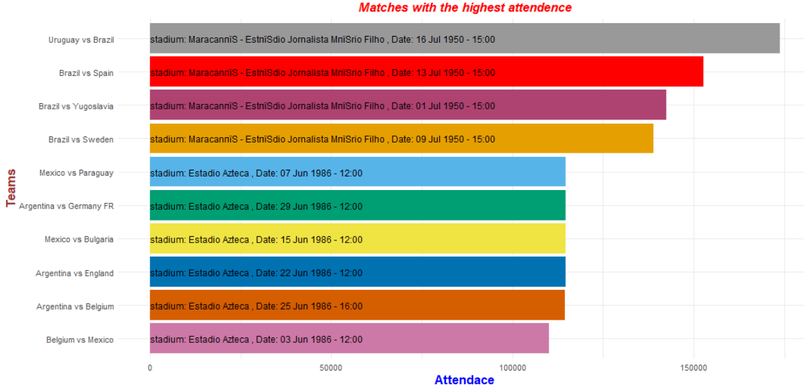

Slide 5
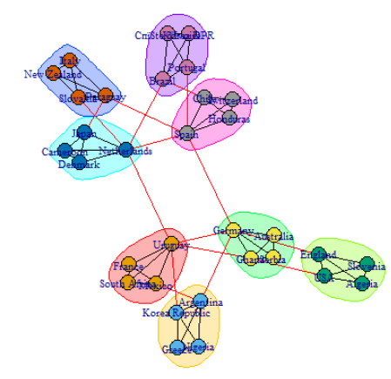
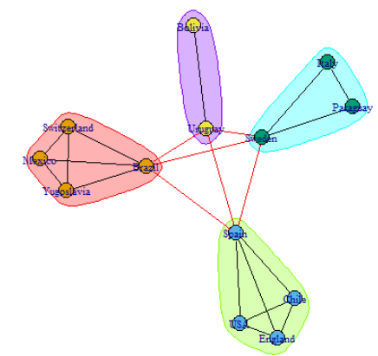
2010
1950

Slide 6
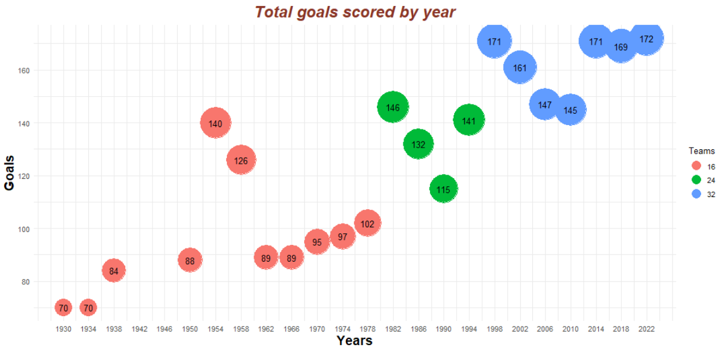

Slide 7
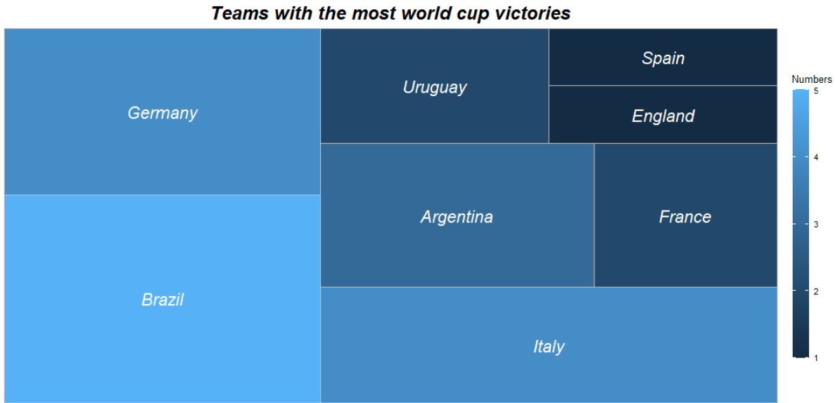

Slide 8
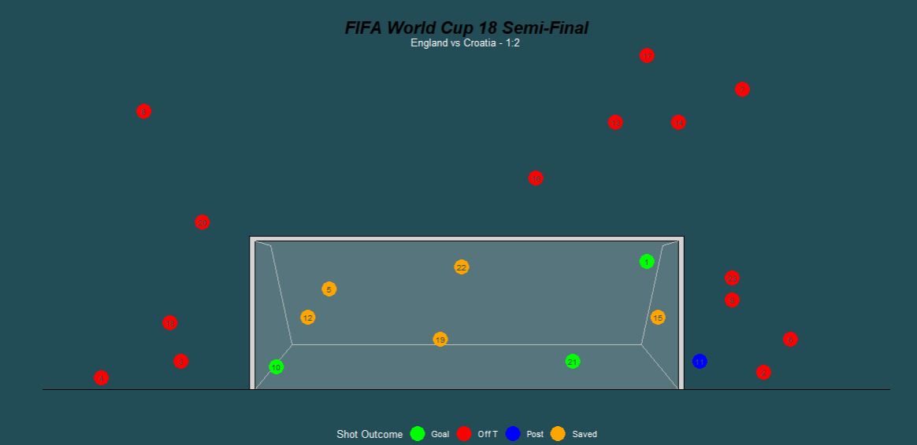

Slide 9
Dataset
It includes data of every 64 World Cup 2022 match: Possession, Goals, Assists, Stage/Group etc.
The data is scraped from Fifa’s official website.
Total of 89 variables.
Tricky challenge: One country may appear either in column “team1” or “team2”.

Slide 10
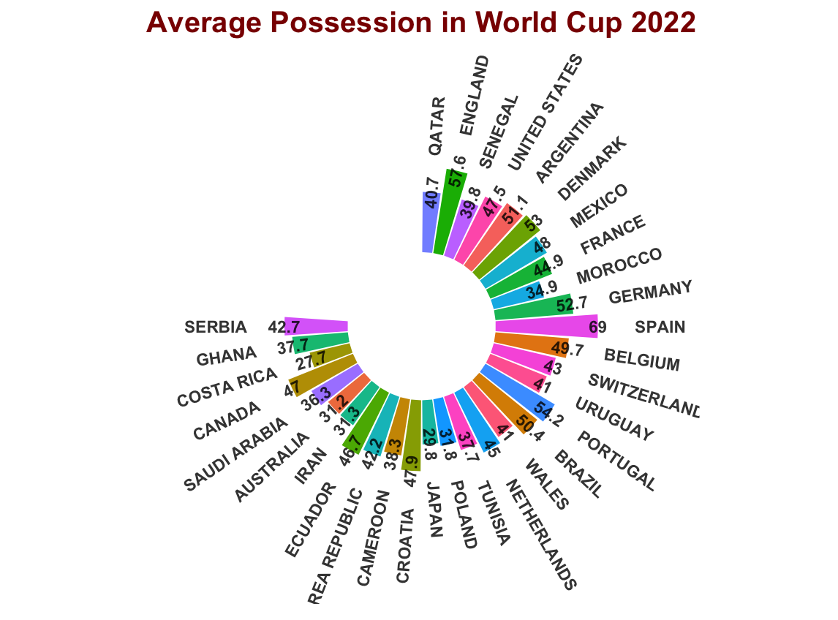
Circular Graph

Slide 11
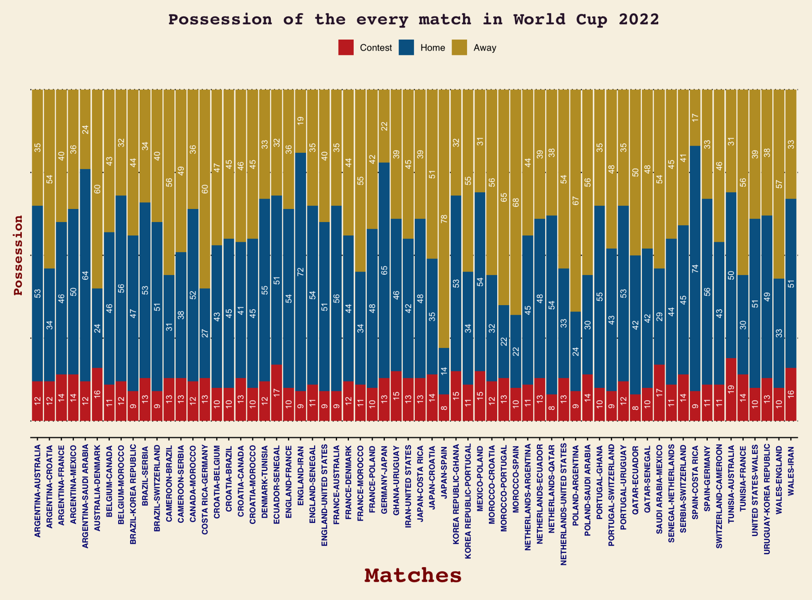
Filled BarPlot

Slide 12
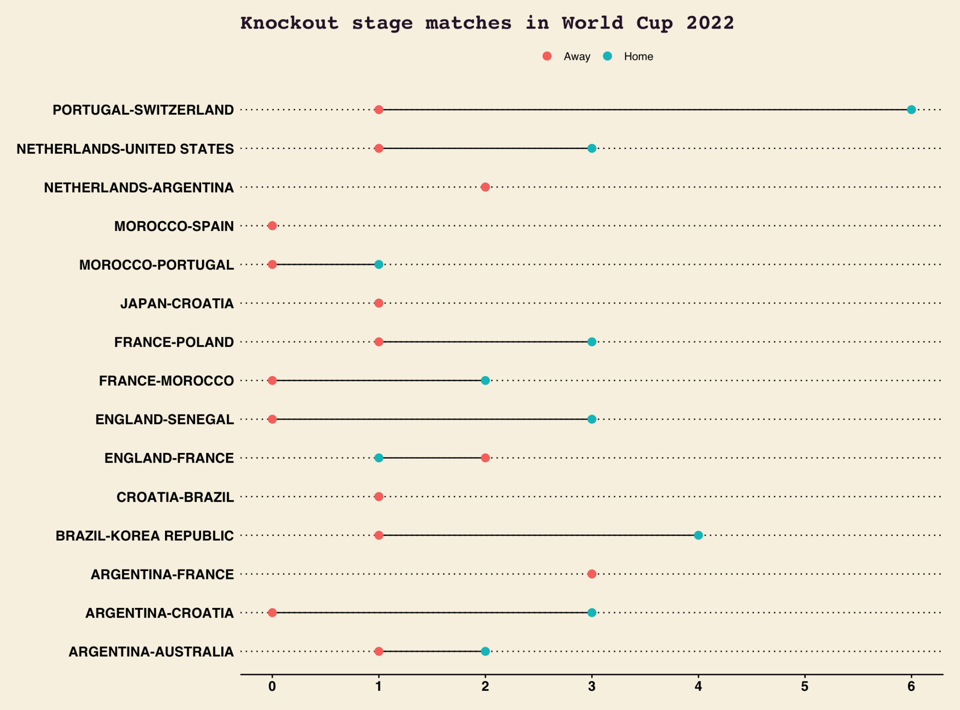
LOLLIPOP: CLEVELAND DOT PLOT

Slide 13
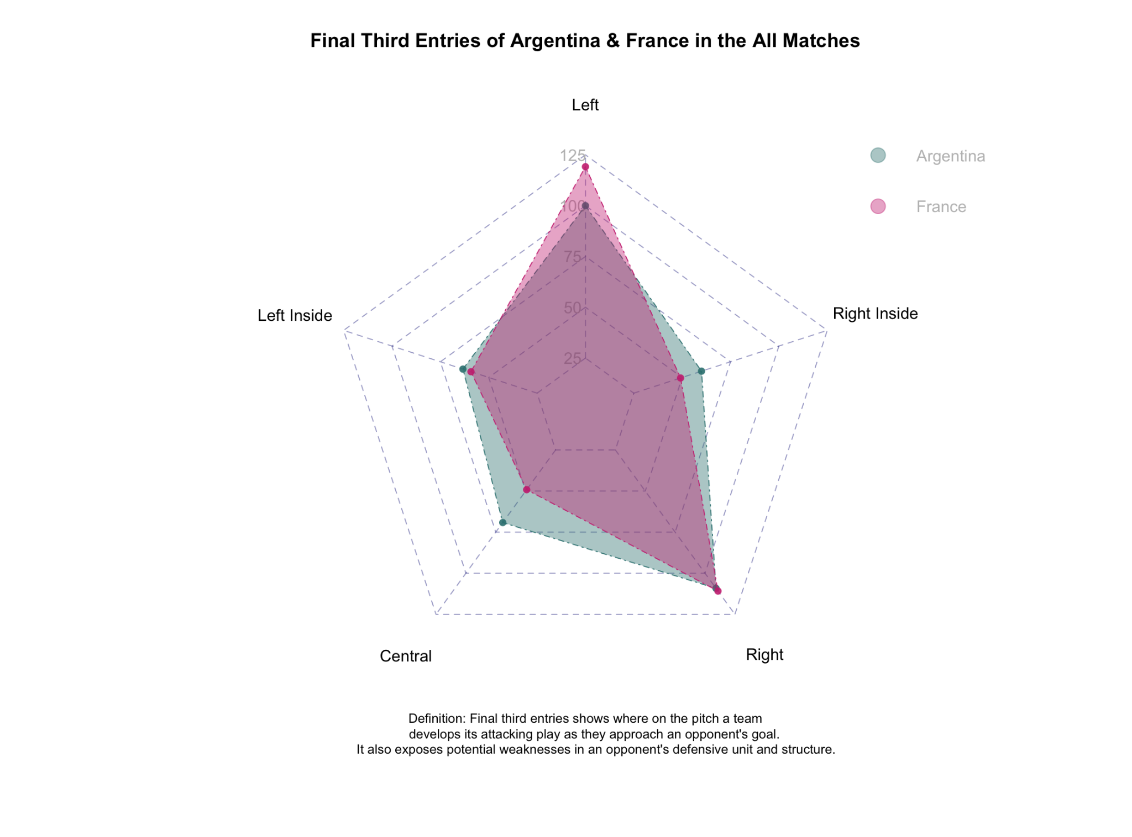
RADAR CHART

